Slide 1
3-7A What is long term memory?
Dr. Terrence Sejnowski

Slide 2
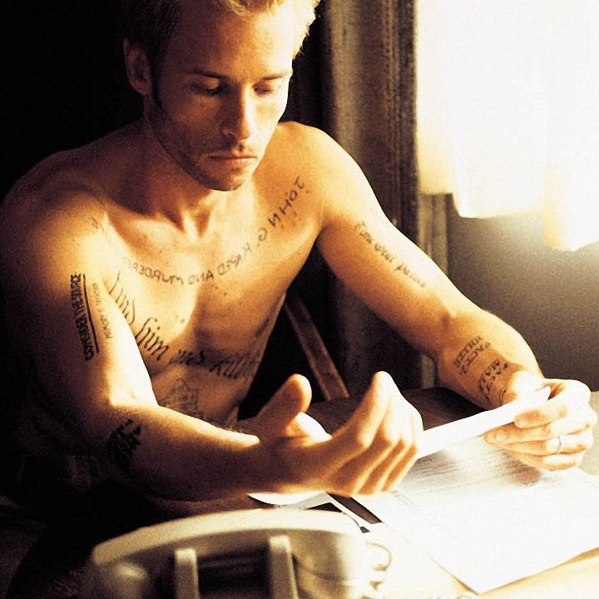
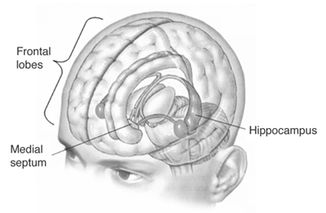

Slide 3
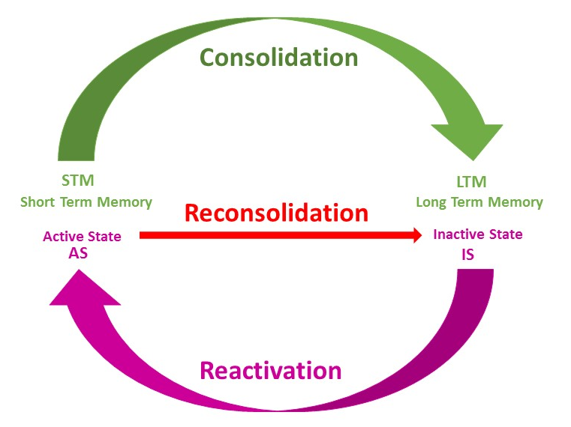

Slide 4
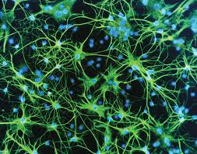

Slide 5
Relevant Readings
Han X, Chen M, Wang F, Windrem M, Wang S, Shanz S, Xu Q, Oberheim NA, Bekar L, Betstadt S, Silva AJ, Takano T, Goldman SA, Nedergaard M. Forebrain engraftment by human glial progenitor cells enhances synaptic plasticity and learning in adult mice. Cell Stem Cell. 2013 Mar 7;12(3):342-53.
Inda MC, Muravieva EV, Alberini CM. “Memory retrieval and the passage of time: from reconsolidation and strengthening to extinction.” Journal of Neuroscience 2011 Feb 2; 31(5):1635-43. PMID: 21289172.
Lee, H.S; Ghettia, A; Pinto-Duarte, A; Wang, X; Dziewczapolskia, G.; Galimic, F; Huitron-Resendizd, S; Pina-Crespoa, JC; Roberts, AJ; Vermac, IM; Sejnowski, TJ; Heinemann, SF; “Astrocytes contribute to gamma oscillations and recognition memory,” Proceedings of the National Academies of Sciences, USA, www.pnas.org/cgi/doi/10.1073/pnas.1410893111, 2014
Image Credits
Most of Molaison's two hippocampi were removed bilaterally, . http://pubs.niaaa.nih.gov/publications/arh27-2/IMAGES/Page191.gif; http://en.wikipedia.org/wiki/Henry_Molaison#mediaviewer/File:Hippolobes.gif
Consolidation image from http://www.hfsp.org/frontier-science/awardees-articles/function-memory-reconsolidation-function-time
Guy Pierce from the year 2000 film Memento, directed by Christopher Nolan.

